Slide 1
Root Cause Analysis as a Quality Improvement Tool for Identifying Barriers to Retention in HIV Care in Uganda
Willy Bikokye Kafeero
CDC Uganda
July 7, 2020
Willy Bikokye Kafeero¹, B. Elur¹, D. Bogere¹, S. Sendagala¹, J. Ssendiwala¹, P. Namukanja¹, A. Namale¹, J. Calnan², A.C. Awor¹, J. Ward¹
1 Centers for Disease Control and Prevention (CDC) Uganda
2 United States Agency for International Development (USAID) Uganda

Slide 2
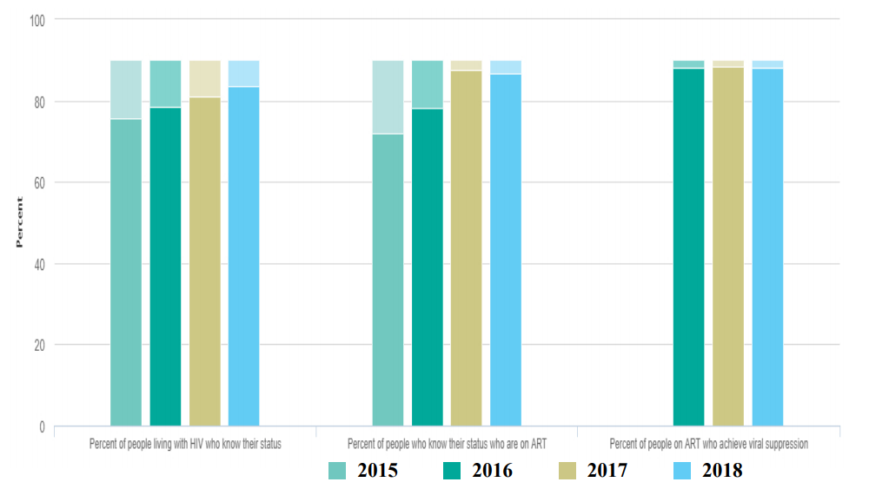
Background: Uganda is closing in on 90-90-90 targets
Uganda is approaching the UNAIDS 90-90-90 targets with 84% of PLHIV knowing their HIV status, 87% on ART and 88% virally suppressed (UNAIDS 2018).
Addressing gaps in retention and viral suppression are critical to sustain program gains made and achieve the 95-95-95 UNAIDS targets by 2030 for epidemic control.
Continuous quality improvement (CQI) efforts to close the quality gaps in the HIV/AIDS treatment cascade, and retention in particular, will be described.
Progress Towards 90-90-90 Target
Source: UNAIDS, 2018

Slide 3
Implementing Root Cause Analysis (RCA) to Trace clients Lost to Follow-up (LTFU)
As of December 2018, Uganda reported 1,004,162 PLHIV receiving ART services.
Between Oct-Dec 2018, 36,702 patients were reported as lost to follow-up (LTFU)
Cross sectional at 152 sites with high numbers (80%) of missed appointments in 56 district
Structured interviews of 36,702 reachable clients that had missed their clinical appointments at health facility or community setting (responses were given by caregivers in case of children).
Question: What was the main reason for missing your appointment at the health facility?
Analysis: Tally and frequency tabulation of client responses. Pareto Analysis used to determine the root causes by applying the 80:20 rule.

Slide 4
Key Findings

Slide 5
CONCLUSION & LESSONS LEARNED
Conclusion
Large scale implementation RCA is feasible and useful in identifying gaps in service quality that impact programming. For retention, while roll out of differentiated service delivery may address transport challenges, further analysis is required to determine best solutions
Results
Of the 36,702 patients initially categorized as LTFU, 5,008 were traced by community peers or reached on phone by facility staff; 95% (4,758) were >15 years, 60% (3,005) females.
From the RCA, of those LTFU were a result of lost clients reported lack of transport or long distance, 19% (950), forgot appointment; 15% (758) while travel away from home, sickness, or work accounted for 12%, 10% and 8.3% respectively.
We have used the findings to introduce multi- month drug refills to support stable clients and plan well with their drug refills as well as supporting those with both planned and emergency travel to reduce drug stockouts

Slide 6
Acknowledgements
All CDC and USAID Technical Staff
Above-Site Implementing partners CDC –METS and USAID –SITES
All CDC and USAID supported Implementing partners
AIDS Control Program / MoH – Uganda Staff
Districts and Health Facilities Staff

Slide 7
Thank You!
The findings and conclusions in this report are those of the authors and do not necessarily represent the official position of the Centers for Disease Control and Prevention.
For more information, contact: mex5@cdc.gov

